Slide 1


Manager’s Guide

Slide 2
What?
Compass Chefs craft moments that matter. Working in the world’s most exhilarating kitchens, our chefs are part of a community with endless creativity, genuine comradery and a shared passion to influence something bigger. Whether it’s inspiring students, offering comfort, fueling recovery, supporting seniors, or uniting fans on game day—behind every meal is a connection to remember.
When?
September 7-13th is our 8th annual Chef Appreciation Week. Managers, work with clients and create opportunities to recognize your teams, build stronger connections and have fun! Appreciation is powerful! Celebrate the chef and all the people, FOH and BOH, who make hospitality happen.
Why Celebrate?
Recognition fuels performance. At every place and stage of life, Compass chefs are proud to be the heart of the house. Where teamwork drives excellence and innovation meets purpose, our 200,000+ culinarians worldwide transform food into celebration, comfort, connection and community.
Share the Website!
A simple ‘thank you’ goes far. We work with incredible chefs around the world! Invite your guests and clients to read their inspiring stories at ChefAppreciationWeek.com. Access it with the Marketing QR code.

Slide 3
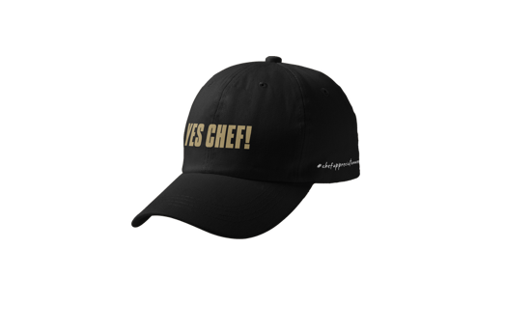





Celebrate in Cafe
Gratitude builds great teams. Create visible “Appreciation Stations” or Shoutout Boards that encourage clients, customers and team members to show the love.
ACTIVITY MARKETING
Have fun getting to know your co-workers.
Together at the Table: Host a family meal before or after service with kitchen and front-of-house employees to create a moment of connection, culture and community.
Bonus Material:
Invite your client to hand out “Certificates of Appreciation” Ask each team member to say one thing they appreciate about Chef.
Give the Gift of Merch! Limited edition Chef Life hats are available for purchase. Your entire team can wear them all week!
Chef Specials: Every Chef has a signature dish, and this is the week to let it shine! Promote your chefs, their favorite recipes and the story behind the meal.
You’re a Rockstar! Appreciation Cards:
Create a display with marketing, pens and cards and encourage guests to share their compliments. These are great to read at preservice or family meal!
Great Women Inspire: Use the template to Showcase female chefs and inspire the next generation, reinforcing culinary excellence comes from skill, creativity and passion.
Nudge & Axonify: Recognition is a ripple effect. Use pins and Spark sessions to shout out your people.
Fun Fact: Use the template to share a passion about each team member and post for co-workers and guests to see.

Slide 4




Client Involvement
Recognizing Talent Certificates are even
more meaningful if clients join in.
Invite your client to stop by the Café or preservice
meeting to thank the team.
An “Invitation to participate” email template
and QBR Slide are on MyCompass to get you started.
Celebrate on Social Media
Include #ChefAppreciationWeek
Instagram and TikTok: Search “ChefAppreciationWeek” to add stickers to your post.
Tag your sector for a bigger audience
Capture Chef’s personal and professional life in a photo series
Post each day during the week
Pre-designed images and Canva Template are available
Chef Q&A Short Videos:
Ask your chef a question and turn it into a video. Ideas:
What do you love about being a chef?
What is a WOW moment made possible because of Compass?
What ingredient or culinary trend are you loving right now?
What advice do you have for young chefs in your field?

Slide 5



Celebrate on Social Media
USE GIPHYS AND STAND OUT!
REMEMBER TO SEARCH:
LOVEMYCHEF
UNDER ‘STICKERS’ TO
LOCATE THE GIPHY’S

Slide 6





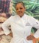

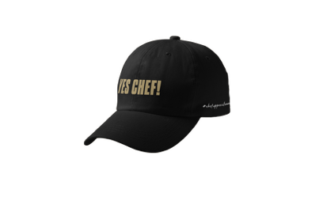
MARKETING
Digital is
available in multiple layouts as well as static & animated.
Order marketing through Innvoke HERE.
*Please log in with your username and password
PRINT & DIGITAL
8.5x11 POS
22x28 POS
24x60 X Banner
33x80 Pull-Up Banner
1920x1080 H Digital
1080x1920 V Digital
ACTIVITY MARKETING
Compliment Cards
5.5x8.5 You’re a Rockstar! Appreciation Cards
36x24 Appreciation Board
8.5x11 Chef Spotlight
36x24 Selfie Frame
HATS
“YES CHEF” Hats are available to order through NewChef and/or ChefWorks. *Please log in with your username and password

